Slide 1






Windows
Operating System

Slide 2

TABLE OF CONTENTS
01
Navigation
04
More Resources
02
System Updates
05
Bonus Topic!
03
Quiz

Slide 3
Navigation

Slide 4

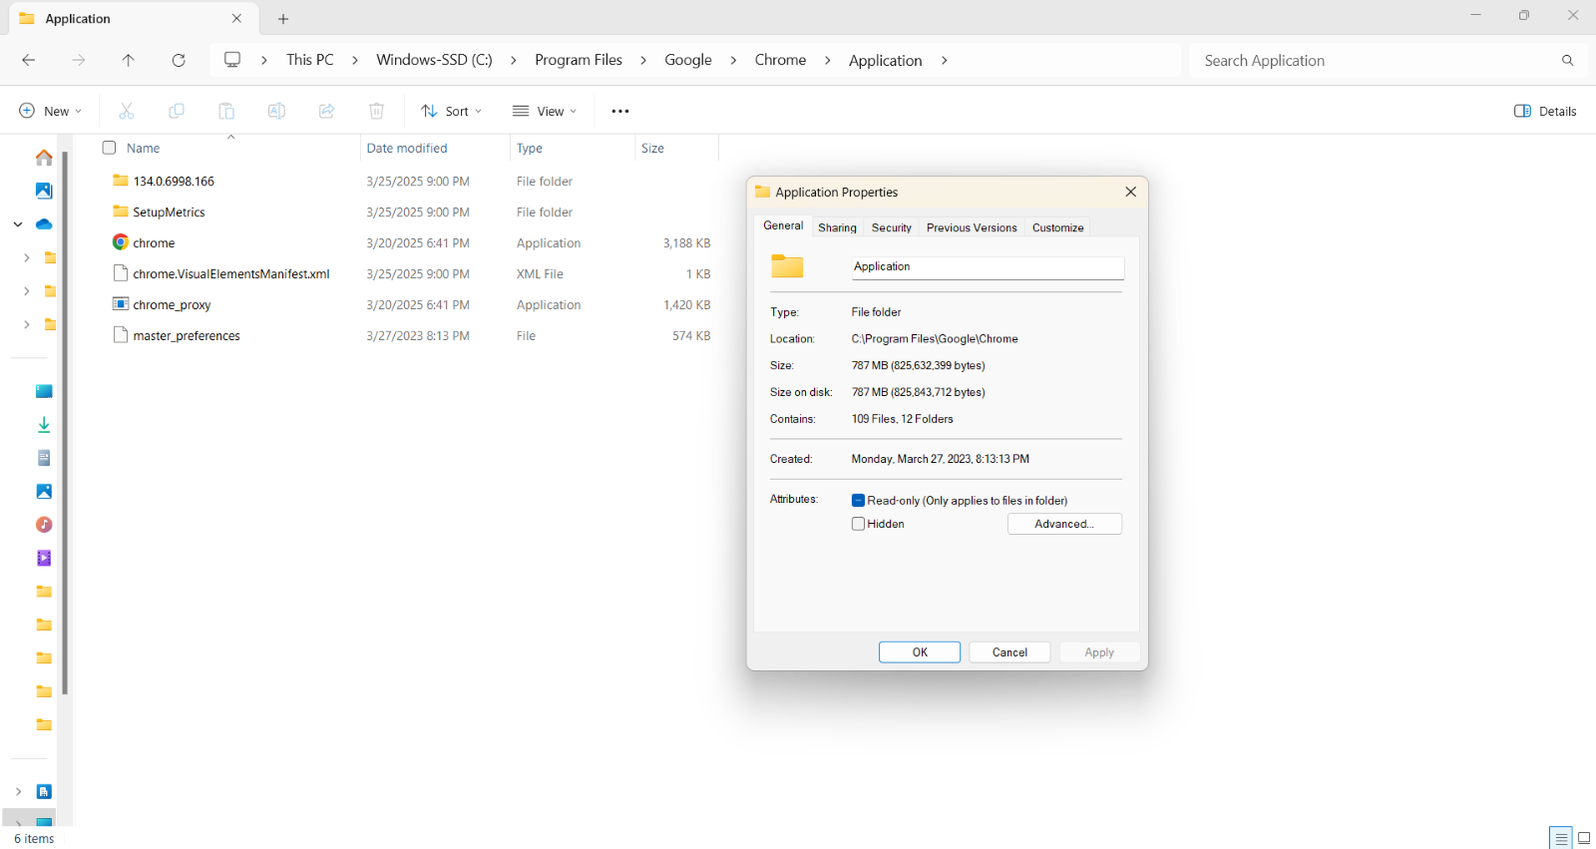
File Paths
File paths specify the location of a directory, folder, or file. A path separator “\” is used to distinguish the folder that a file or another folder is in.
You can access a file’s path by right-clicking on it and clicking “Properties” or clicking in the URL box near the top.
This example shows the location of the chrome.exe file. The path location is C:\Program\Files\Google\Chrome\Application\chrome.exe. C: is the drive. Files, Google, Chrome, and Application are folders. chrome.exe is a file.

Slide 5





WW
File Extensions
File extensions are the letters at the end of a file name after the period. They indicate which type of file it is, allowing the operating system to handle the file properly.
Common file extensions:
.bat – executable batch files
.bmp – Bitmap graphics files
.docx – Word documents
.exe – executable files/programs
.jpg, .jpeg - Joint Photographic Experts Group photo file
.pdf - portable document format file
pptx – PowerPoint files
.txt - text file
.wav – Microsoft audio file
.wmv – Windows Media Video
.xlsx – Excel spreadsheet
.zip - compressed file

Slide 6
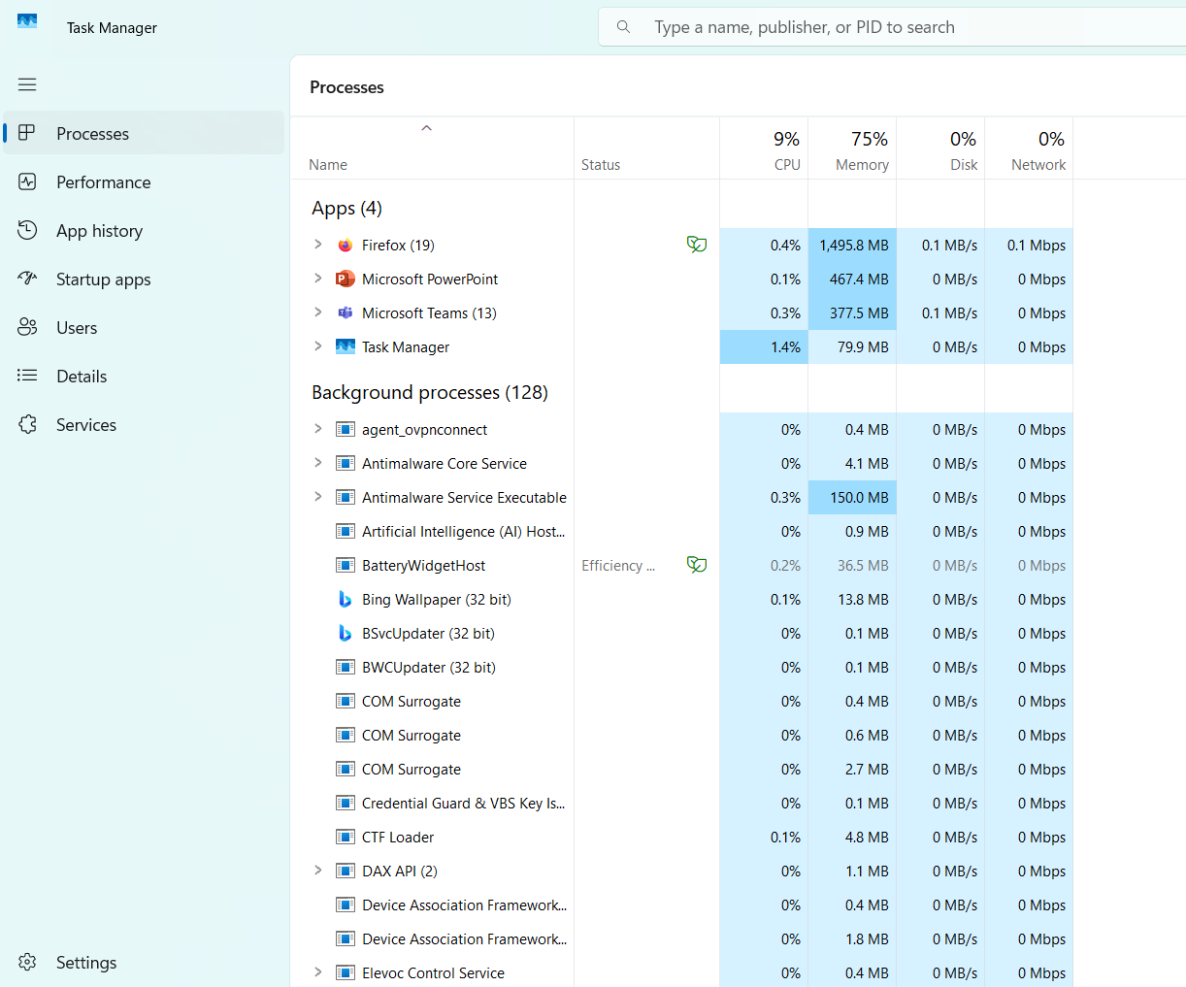

Task Manager
The Task Manager allows you to view the performance of your system. You can see the usage percentage of the CPU, memory, disk, and network overall and for each process.
In the Task Manager, you can do many things to a process, like end it, restart it, create a dump pile (which is a debugging tool), go to detail, open file location, search online, or view properties.
To access the Task Manager, you can either hit Ctrl + Shift + Esc on your keyboard, or you can right-click on the Windows taskbar and click Task Manager.
Open Task Manager on your computer and view the processes that are running!

Slide 7



Recycle Bin &
Start Menu
Recycle Bin
Start Menu
The Recycle Bin is a temporary storage area for deleted files and folders. They will be stored in the Recycle Bin for 30 days and then will be automatically deleted. You can also go in and delete things in the Recycle Bin manually. It is typically on the Desktop.
The Start Menu provides quick access to applications, files, and settings. It can be accessed by clicking the Windows logo in the taskbar or hitting the Windows key on the keyboard.
Go to your Recycle Bin and see if you can figure out how to restore a file! The answer will be with the quiz answers!

Slide 8
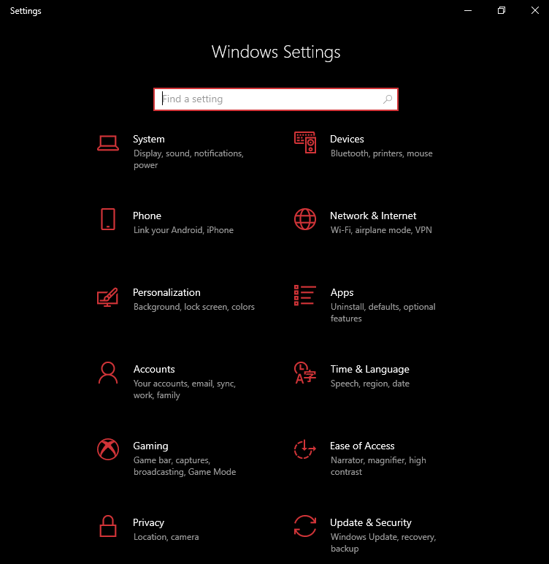
Settings
Settings is the central application for managing and customizing the device. It can be accessed by going to the Start Menu. It might be pinned on your Start Menu, or you can use the search bar and search for “Settings”.
Settings is organized into categories, which allows you to easily search for a setting by category.
If you’re looking for a specific setting and aren’t sure which category it would be in, you can always use the search bar built into the Settings application.

Slide 9
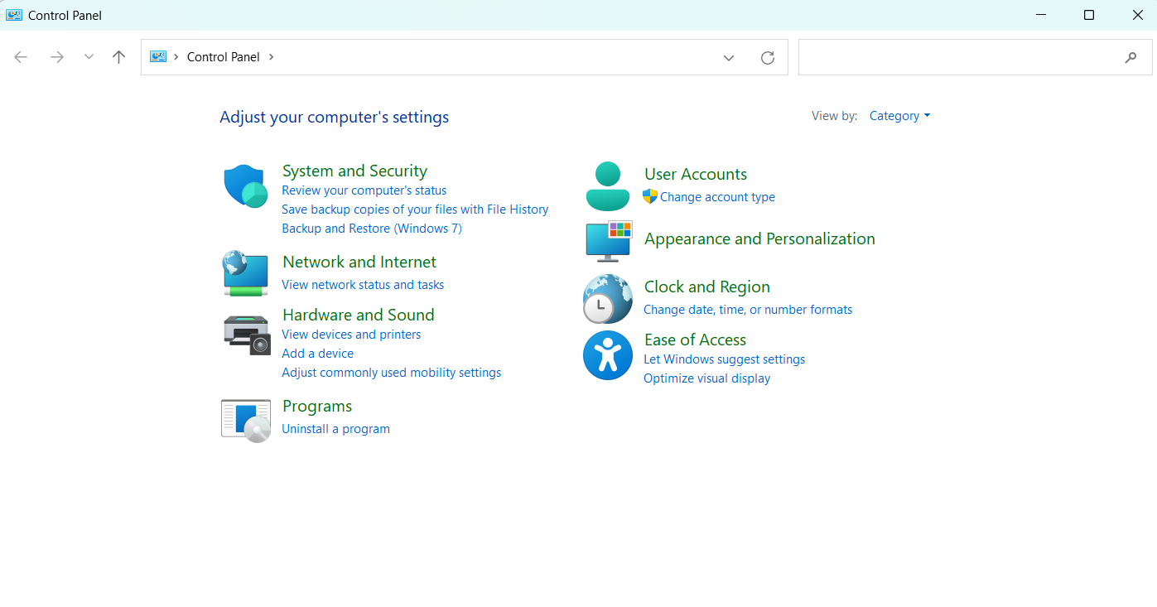
Control Panel
The Control Panel allows you to view and adjust system settings. In the Control Panel, the settings are organized by category. You can change the “View by:” to either small or large icons to be able to see all Control Panel items.
To access the Control Panel, just search “Control Panel” in the Start Menu.
Just like in Settings, you can use the search bar in the Control Panel when trying to find a specific setting.

Slide 10
System Updates

Slide 11
WW
Why System Updates?
If a security vulnerability is found within a program, a patch, which will cover that vulnerability, is made and released by the vendor as a system or software update. It is important to install the update as soon as possible to prevent attackers from using those vulnerabilities.

Slide 12
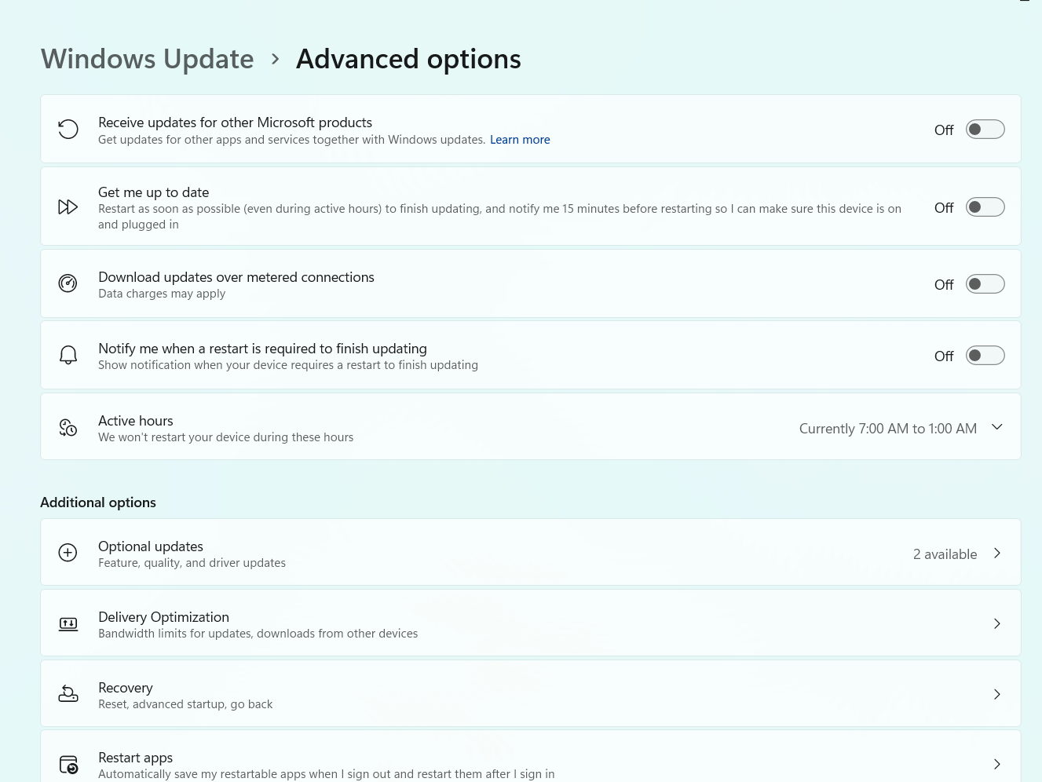
Installing a System Update
To install a system update, open Settings and go to the “Windows Update” category. From here, you should be able to check for any updates and install them if there are any available.
Additionally, you can go into “Advanced options” and turn on or off the options to receive updates for other Microsoft products, notify me when a restart is required to finish updating, etc.

Slide 13

QUIZ!
Test your knowledge! Remember your answers so you can check them at the end!

Slide 14



Question 1
What does the path separator do in a file path?
Separates files and folders within the file path
Converts file names to uppercase
Deletes files automatically

Slide 15
Question 2
What is the purpose of a file extension?
To make files run faster
To indicate the file type
To increase the file size

Slide 16
Question 3
How long does the Recycle Bin store files before deleting them automatically?
30 days
One year
10 days

Slide 17
Question 4
What feature provides quick access to applications, files, and settings?
Start Menu
Task Manager
Control Panel

Slide 18
Question 5
Which application allows you to view and adjust system settings?
Task Manager
Control Panel
Recycle Bin

Slide 19
Question 6
What does a patch do?
Creates a backup file
Deletes unnecessary files
Covers a vulnerability

Slide 20


Quiz Answers
Question 1
The path separator separates files and folders within the file path.
Question 2
File extensions indicate the file type.
The Recycle Bin stores files for 30 days before automatically deleting them. You can restore items in the Recycle Bin by right-clicking on the item and hitting “Restore”.
Question 3

Slide 21
Quiz Answers
Question 4
The Start Menu provides quick access to applications, files, and settings.
Question 5
The Control Panel allows you to view and adjust system settings.
Question 6
A patch covers a vulnerability.

Slide 22

More Resources
If you would like to do further research on the Windows operating system, here are a few good resources:
01
https://support.microsoft.com/en-us/windows - If you are looking for how to do something specific, it can be easy to search for on this website!

Slide 23
Bonus Topic:
DNS

Slide 24
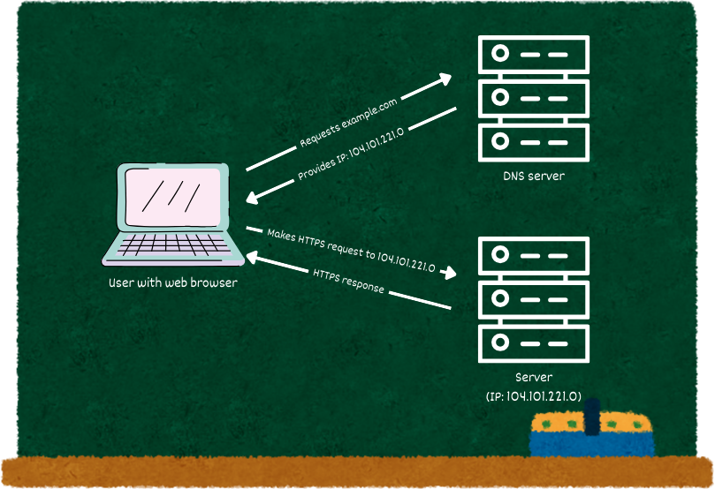
What is DNS?
The Domain Name System (DNS) translates domain names to an IP address, which is connected to a device on the Internet. When you type a web address into your web browser, like example.com, the translated IP address is used to locate the webpage for example.com.

Slide 25

WW
Bind9
The Berkeley Internet Name Domain (Bind9) is a common open-source DNS system that allows you to publish your DNS information on the Internet and resolve DNS queries for your users. Bind9 can be tailored to your organization’s requirements.

Slide 26


THANK
YOU!

